Slide 1

Swahili Language Model for Mozilla Builders 2024
Dr Michael S. Mollel (PhD)
Co-Founder & CEO Sartify LLC

Slide 2
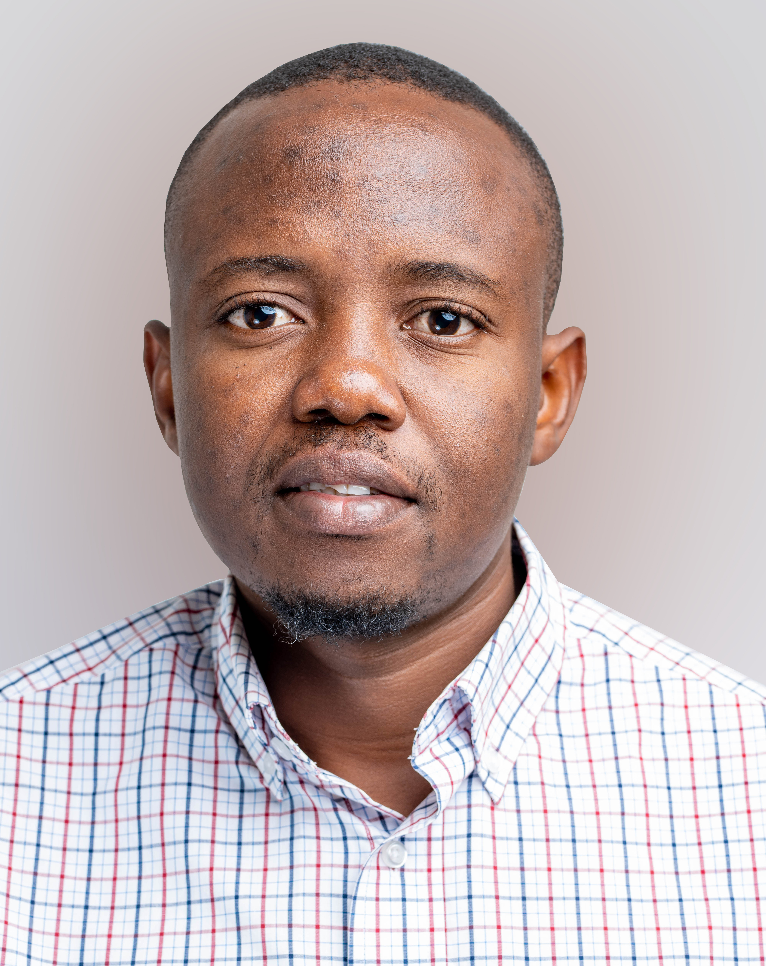
About Sartify
Co-Founder & CE0
Dr Michael Mollel, Co-Founder and CEO of Sartify LLC, has PhD in Information Communication Science and Engineering from NM-AIST & UOG. Experience in AI, ML, and 5G wireless communications. Senior Researcher at the University of Glasgow. Received multiple awards - PhD Research Award from NM-AIST (2020), IEEE WCNC Best Paper Award (2019), and the best AI Use Case ITU Geneva (2024). Email: michael.mollel@sartify.com

Slide 3
Overview of the Presentation
Introduction to AI
Introduction to Artificial Intelligence (AI)
AI in Social Security Funds
Key AI Technologies
AI Applications and Future
Use Cases in Social Funds
Benefits and Challenges
Future Directions
Notes:
Slide 2: Welcome and Opening Remarks
A very warm welcome to all of you present here today for this insightful presentation on "Artificial Intelligence and Its Applications: Shaping the Future of Technology in Tanzania."
It is my honor to have the opportunity to discuss this highly relevant and transformative field that holds immense potential for driving technological advancements and economic growth in our nation.
Artificial Intelligence, or AI, has rapidly evolved from a theoretical concept to a powerful technology that is reshaping industries, businesses, and our daily lives.
In this presentation, we will explore the fundamentals of AI, its current applications across various domains, and its potential impact on Tanzania's technological landscape.
We will delve into the opportunities and challenges presented by AI, and how we, as a nation, can harness its capabilities to drive innovation, efficiency, and sustainable development.
By understanding the capabilities and implications of AI, we can better prepare ourselves to embrace this disruptive technology and position Tanzania as a leader in the digital revolution.
I encourage you all to engage actively throughout the presentation, as your insights and perspectives will contribute to a deeper understanding of this fascinating topic.

Slide 4
Project Overview

Slide 5
Project Overview
Project Name: A Conversation Large Language Model for Swahili Use Cases and Retrieval Augmented Generation
Project Type: New capabilities built off an existing project
Objective: To create a Swahili LLM (Large Language Model) capable of answering general questions and integrating into various Retrieval-Augmented Generation (RAG) systems for diverse applications.

Slide 6
Origin Story
Need: Existing biases and limitations in LLMs for Swahili
Solution: Continue pretraining LLaMA-2 with 5GB of Swahili text data
Result: Developed a model that performs exceptionally well in Swahili

Slide 7
Project Summary
Multilingual System: Handles both Swahili and English, accommodating Kiswa-English mix
Impact: Reach over 150 million Swahili speakers, inspiring innovation and accessibility in AI applications

Slide 8
Local AI Relevance
Language and Cultural Relevance: AI model designed for Swahili
Local Dataset Creation: Swahili text from newspapers, blogs, etc.
Accessibility and Inclusivity: Open-source Swahili language model
Support for Local Innovation: Encouraging AI research and development

Slide 9
Project Objectives
Language Inclusivity: Making AI technologies accessible for Swahili-speaking communities
General Query Response: Accurate responses in Swahili and English
RAG Integration: Enhance applications like education and healthcare
Cultural Relevance: Reflecting Swahili-speaking population nuances
Innovation and Accessibility: Inspire research and innovation in East Africa
Societal Impact: Contribute to societal development

Slide 10
Creativity
On-Device AI: Deployable on various devices, ensuring privacy and real-time interaction
Enhanced Privacy: Data remains on-device, ensuring user trust
Offline Functionality: Use without internet connectivity
Local Innovation: Create tailored AI applications for specific regional needs

Slide 11
Technical Implementation
Foundation Model Development: Pre-training on extensive Swahili datasets
Fine-Tuning: Using ORPO and DPO techniques for various applications
Open-Source Collaboration: Datasets available on Hugging Face
Benchmarking and Evaluation: Establishing leaderboards for performance tracking
Global Contribution: Aligning with international AI benchmarks

Slide 12
Deliverables
Enhanced Swahili Dataset: Expand to 10GB
Pre-trained Models: Based on Phi-3 and Gemma 9B architectures
Fine-tuned General Swahili LLM
Domain-Specific Models
On-Device Deployment Package
Open-Source Repository: Models on Hugging Face
Benchmark Suite
API and Integration Tools
Demo Applications
Documentation and Tutorials
Research Publications
Community Building

Slide 13
Success Metrics
Technical Performance: Top scores on the Swahili LLM leaderboard
Adoption and Usage: 10,000+ downloads, 50+ integrations
Community Impact: 500+ active members
Research Impact: 100+ citations
Real-World Application: Large-scale deployment
User Satisfaction: 85%+ satisfaction rate
Computational Efficiency: On-device deployment with response times under 100ms

Slide 14
Funding Requirements
Total Requested: $80,000
Allocation:
Data Collection: $20,000
Training and Processing: $20,000
Hardware Infrastructure: $40,000

